Slide 1
Using Tidal Disruption Events to See the Unseeable
Aaron Goldtooth
Advisor: Ann Zabludoff

Slide 2
Black Holes are notoriously difficult to observe.
Tidal Disruption Events offer unique opportunities to observe and measure the properties of black holes.

Slide 3
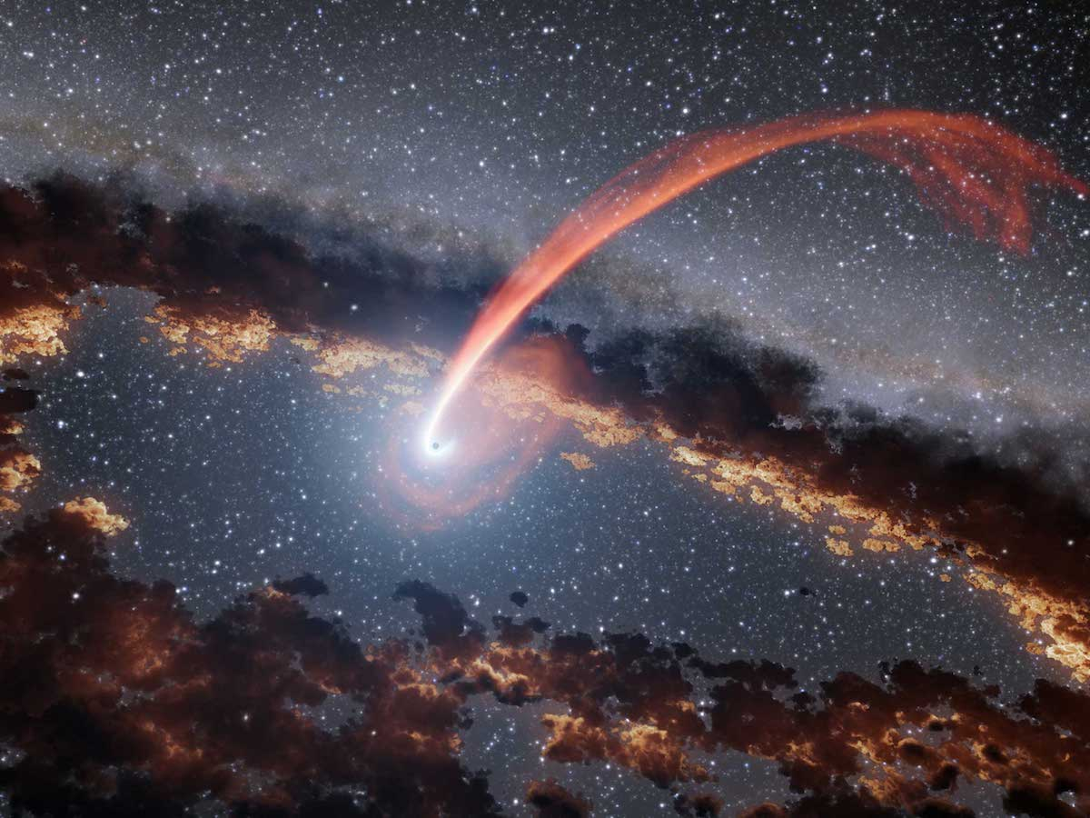
Tidal Disruption Events (TDEs)
Occurs when differential gravitational attraction between objects exceeds forces that hold one of the objects together.
Star disintegrates and forms accretion disk around black hole.
Image courtesy of NASA/JPL-Caltech
Illustration of a TDE

Slide 4
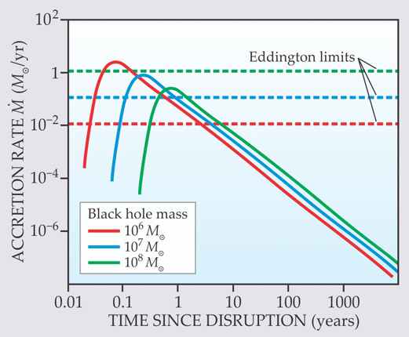
Importance of Tidal Disruption Events (TDEs)
Accretion disks produce observed high energy radiation.
Spectral analysis and model-fitting constrain black hole mass, spin, accretion rate.
Image courtesy of Physics Today
Black Hole Accretion Rate vs Time

Slide 5
Project Goals
TDEs very rare, black hole info limited.
Unify and create single open source document on all known TDEs.
Visually represent timeline of observations.
Help construct first distributions of black hole masses and spins.

Slide 6
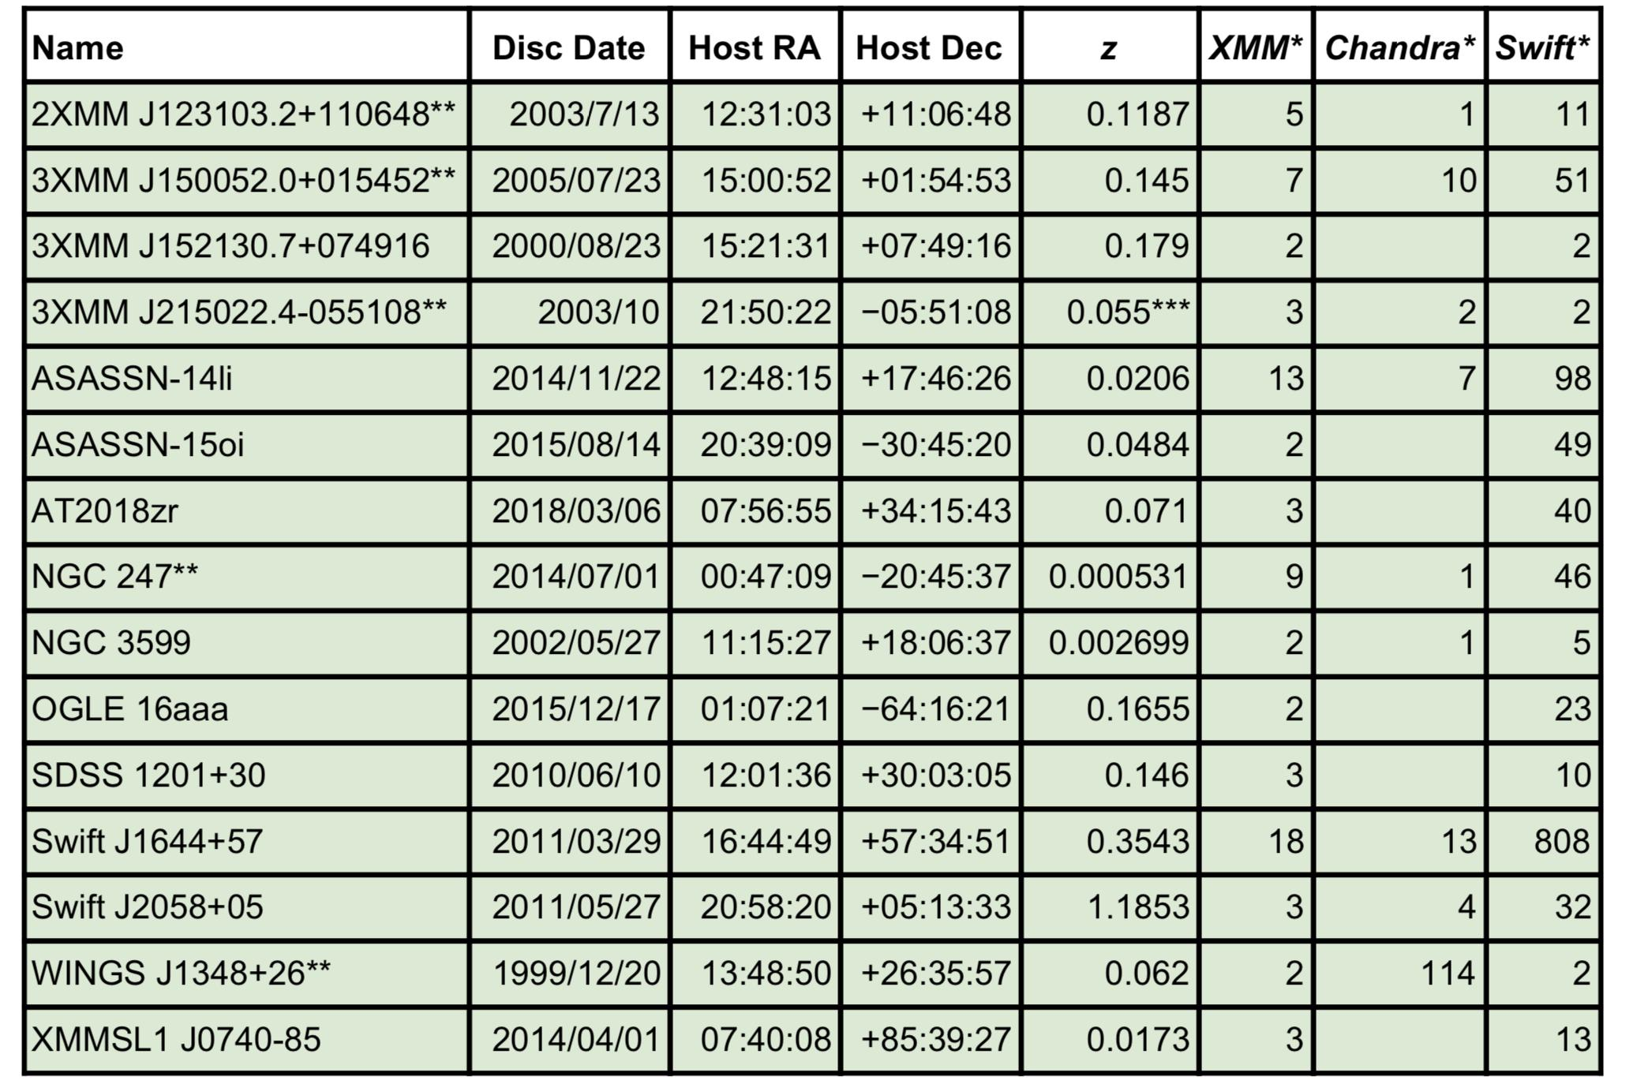
TDE Table Sample
Table 1. ​Examples of TDE Candidates with Deep, Multi-Epoch, Archival X-ray Data
Each TDE here represents ideal candidate for modeling.
Model relies on X-ray data over days, months, and even years.
*Number of unique dates after TDE discovery for which there is a >1 ksec observation. ​At least 10 additional TDE candidates are similarly well-sampled in the NASA mission archives. Some of these pointings are serendipitous, e.g., WINGS J1348+26 lies in the rich galaxy cluster Abell 1795. **​IMBH candidate.​ ***Redshift estimate.

Slide 7
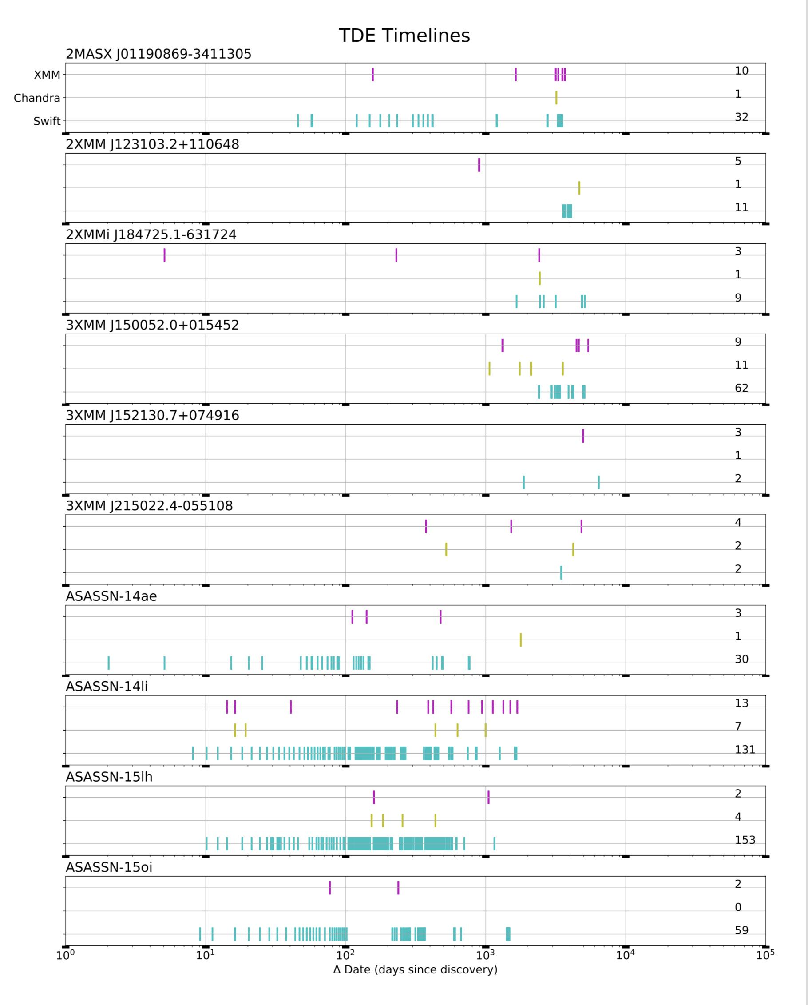
Timeline Plots Sample
TDEs are time-dependent.
Visual representations of observational events makes choosing data for fitting easier.

Slide 8
Recap
Black Holes difficult to observe but test our theories about the universe.
Individual TDEs constrain Black Hole properties like mass and spin.
My project will allow for first distributions of mass and spin.

Slide 9
Acknowledgements
Dr. Ann Zabludoff — Project Mentor
Michelle Coe — Program Manager
Arizona Space Grant Consortium and UA/NASA Space Grant Program
The material contained in this document is based upon work supported by a National Aeronautics and Space Administration (NASA) grant or cooperative agreement. Any opinions, findings, conclusions or recommendations expressed in this material are those of the author and do not necessarily reflect the views of NASA. This work was supported through a NASA grant awarded to the Arizona/NASA Space Grant Consortium.

Slide 10
Image Credits
Tidal Disruption Event Illustration
NASA/JPL-Caltech
Accretion Rate Graph
Gezari, Suzi via Physics Today
The material contained in this document is based upon work supported by a National Aeronautics and Space Administration (NASA) grant or cooperative agreement. Any opinions, findings, conclusions or recommendations expressed in this material are those of the author and do not necessarily reflect the views of NASA. This work was supported through a NASA grant awarded to the Arizona/NASA Space Grant Consortium.

